Slide 1



Get Pumped Up for Success!
Kindergarten

Slide 2






What We Will Cover
Things to Know
What to Expect
Introduction Videos
Tips
Let’s Remember

Slide 3

“Why are we taking the
i-Ready Diagnostic?”

Slide 4




Why take the i-Ready Diagnostic?
Remember, the Diagnostic helps us:
Find out what you know
Understand what you
are ready to learn
  Make the best use
  of your learning time

Slide 5
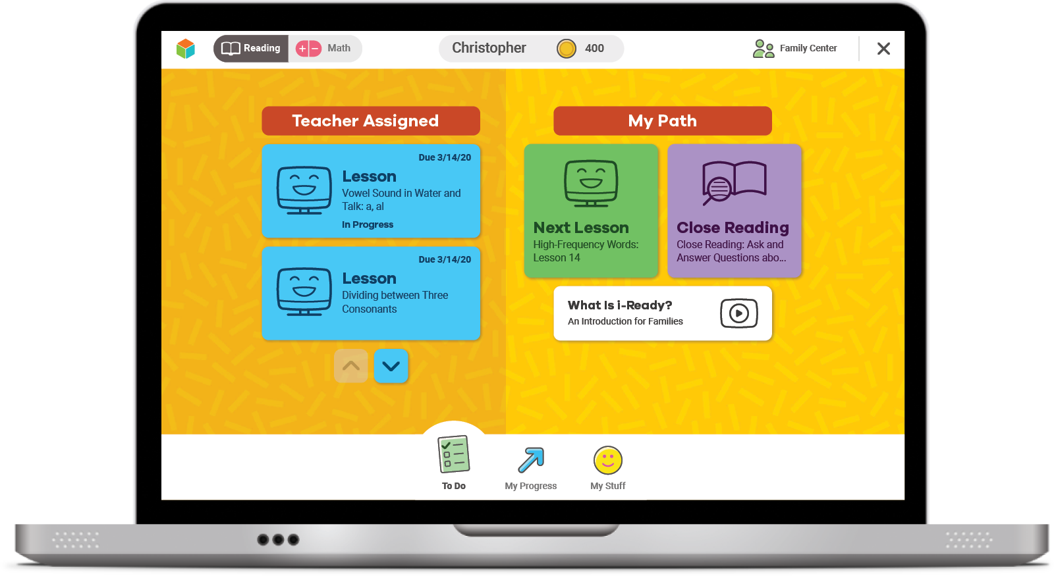
Online Lessons
After your Diagnostic, you'll get new Lessons.
If you try your best on the Diagnostic, online lessons will match what you need to learn.

Slide 6



How does the Diagnostic work?
i-Ready is adaptive. This means the questions change based on your answers to earlier questions. You will see questions you won’t know how to answer. That is okay!
Some questions will be . . .
Hard
Easy
Just Right!

Slide 7
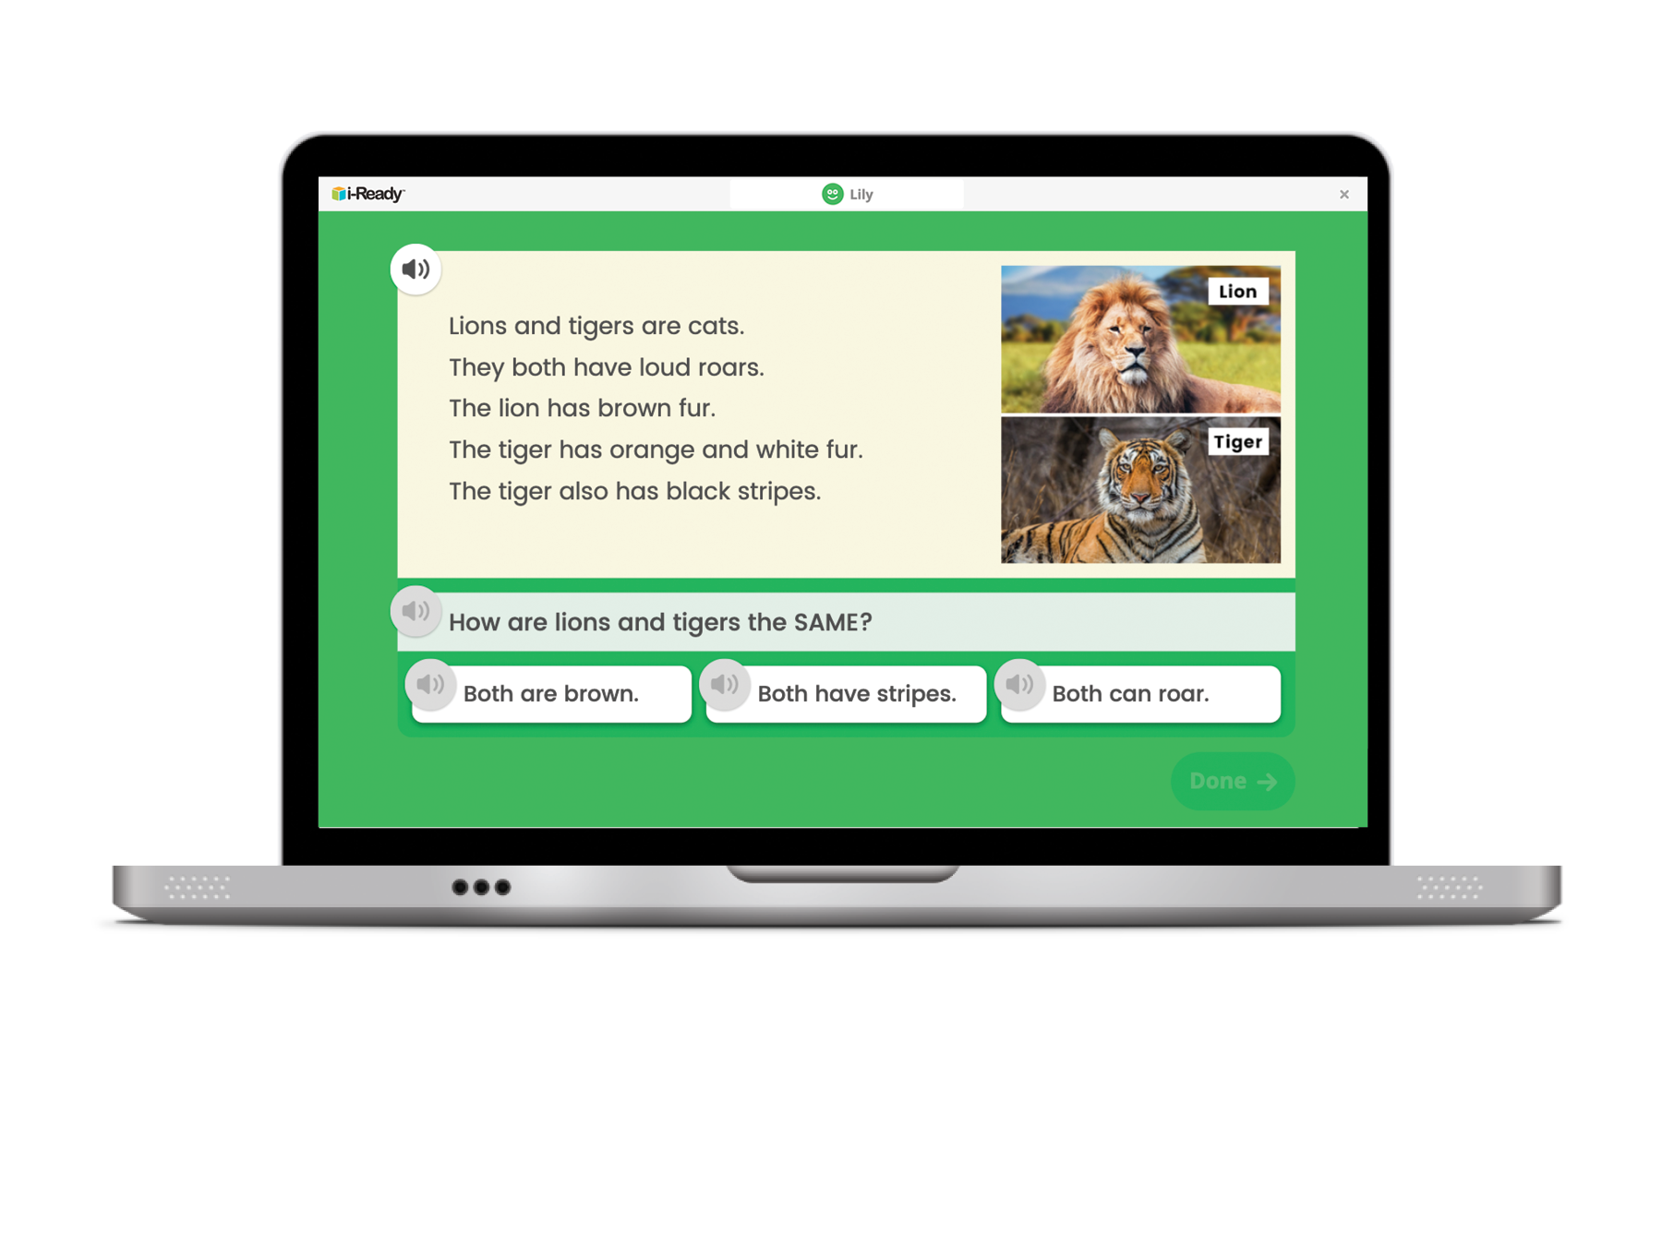
How does the Diagnostic work?
You might see a question that looks like this.

Slide 8

Why is the Diagnostic really important now?
This past spring, you were learning from home.
Doing your best on the Diagnostic now will help you and your teacher know what you learned while you were at home and what you are ready to learn.

Slide 9

What should you do?
Try your best.
Do not rush, but do not spend too much time on any one question.

Slide 10
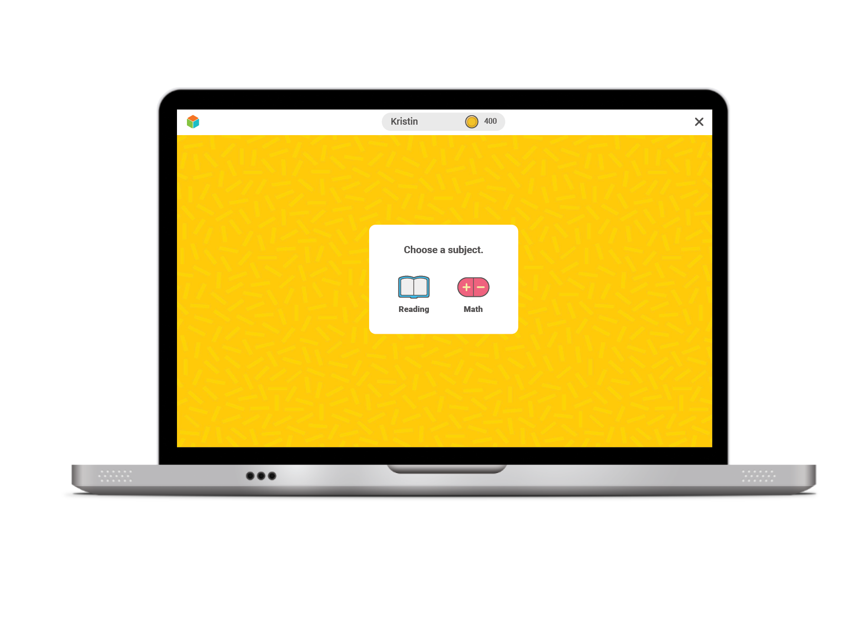

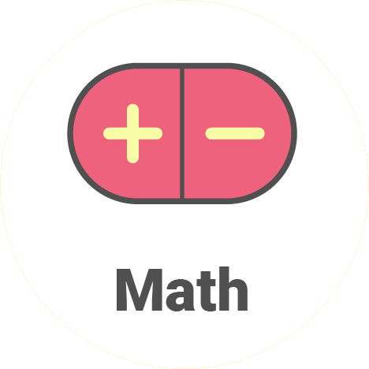
Once you log in, you will see this:
For Reading,
click on the book.
For Math, click on the math signs.
I will tell you which one to click.

Slide 11
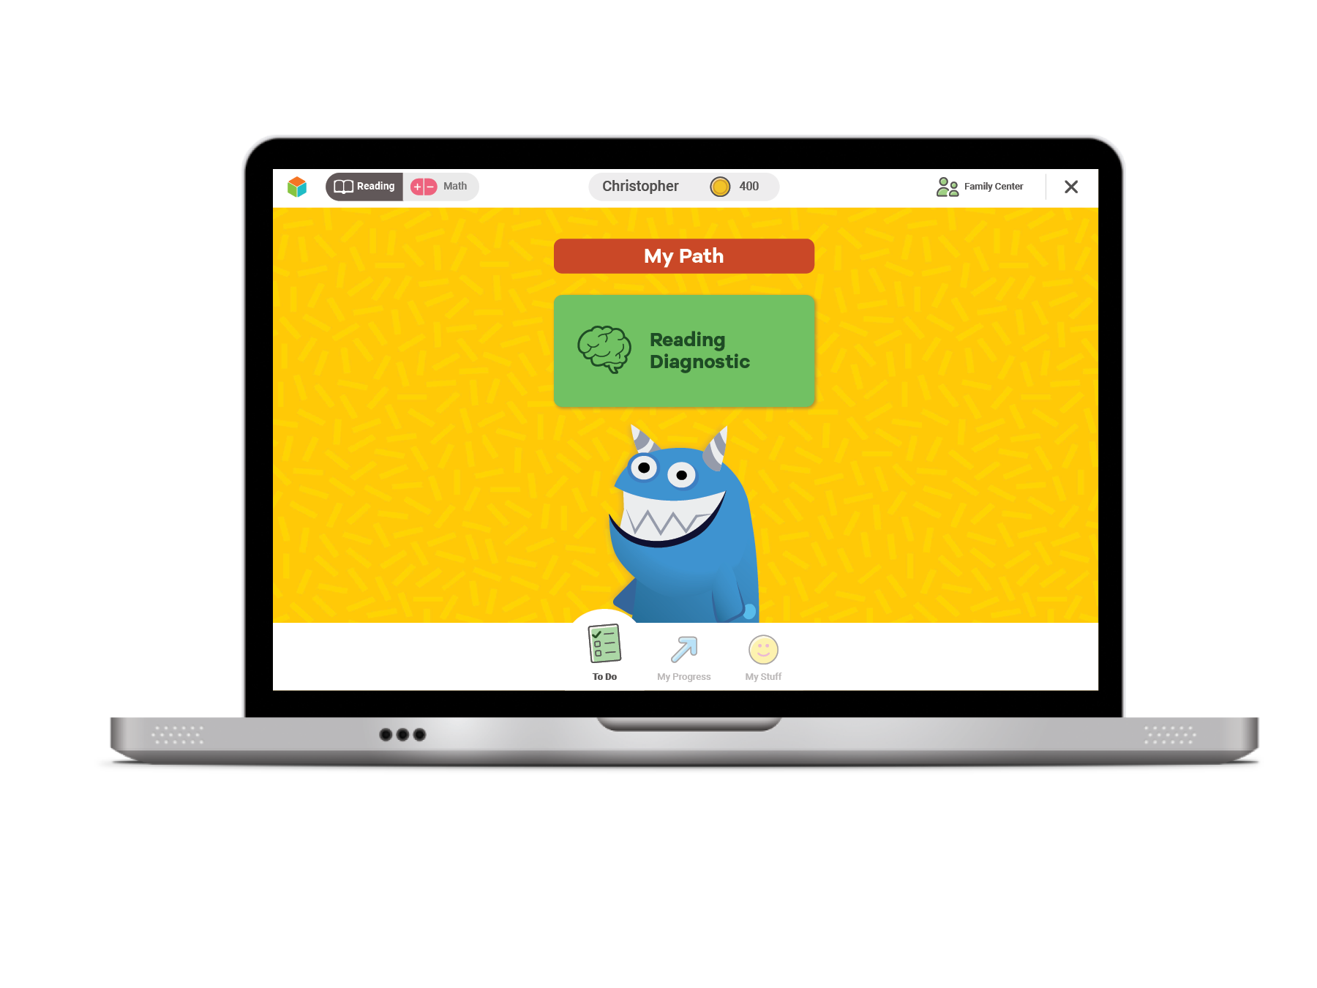
Next, you will see a page like this:
Click the green button to start your Diagnostic.

Slide 12
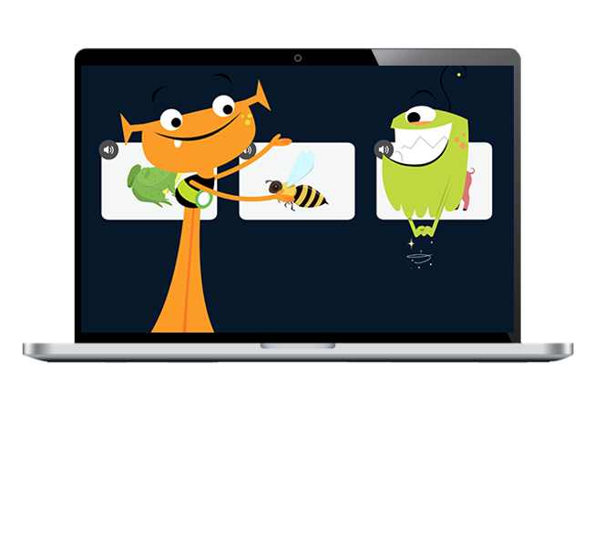
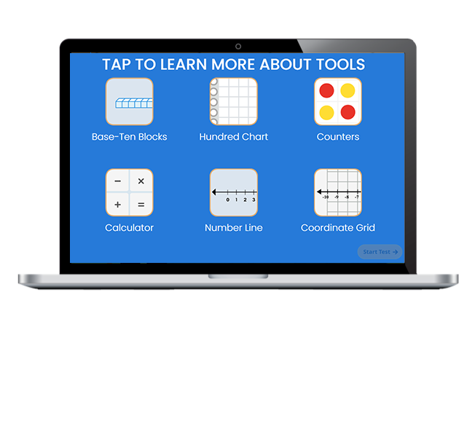
Next, you will:
Watch a video.
Click on each button to watch a video about a tool.
Then select START TEST.

Slide 13
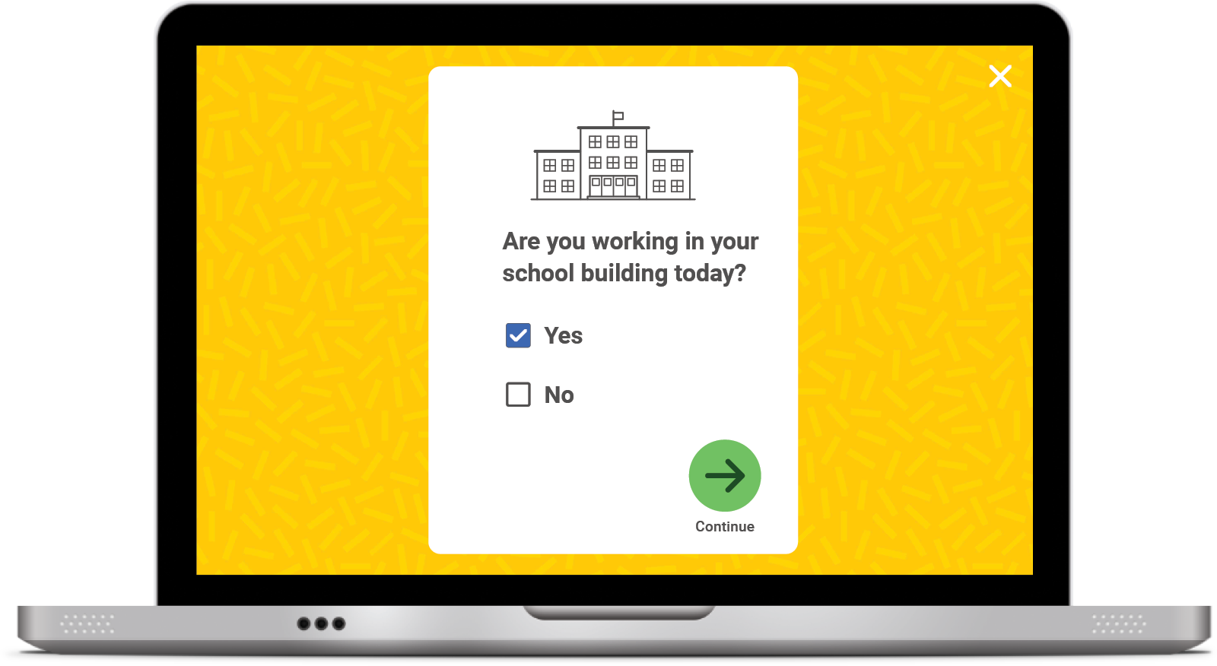
Student Survey
Once you START or RESUME your Diagnostic, you will see this question pop up on your screen:
Click No if you are taking the Diagnostic at HOME.
Click Yes if you are taking the Diagnostic at SCHOOL.
Click the green arrow to move on.

Slide 14


Optional
Introductory Demo Videos
You will get to try this on your own!
MATH
READING
Optional

Slide 15



Helpful Tips
Take your time and do not rush.
Read each question and
answer choice carefully.
Try your best! Remember: Just like
when we are at school, your
teacher and family cannot help!

Slide 16




Helpful Tips
For Math—Show your work.
For Reading—Read each passage carefully.
Check your work.

Slide 17
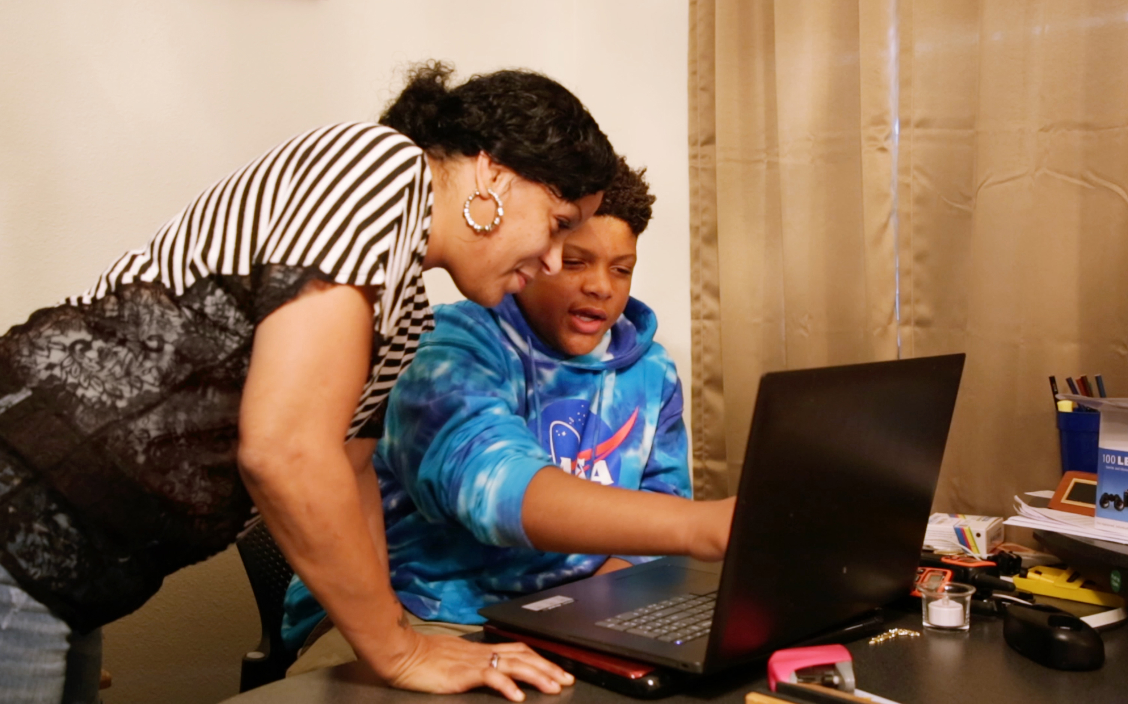
Our Plan
After the Diagnostic, i-Ready creates a special report for you and your family.

Slide 18

Optional
Our Incentives
Class incentives
Individual incentives
Optional

Slide 19

Let’s Remember . . .
To do my best on
i-Ready,
I will . . .

Slide 20

You Will Rock It!

Slide 21
Embedded Universal Supports
Grades K–8

Slide 22
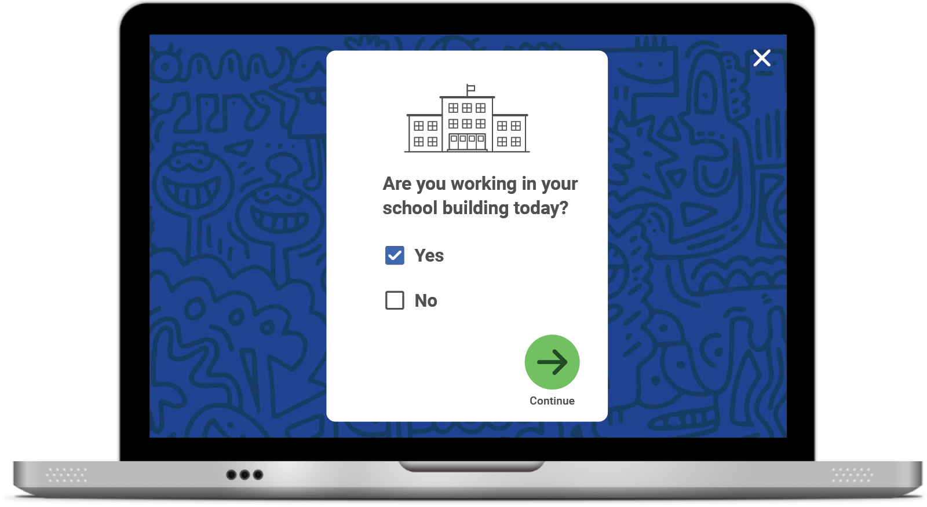
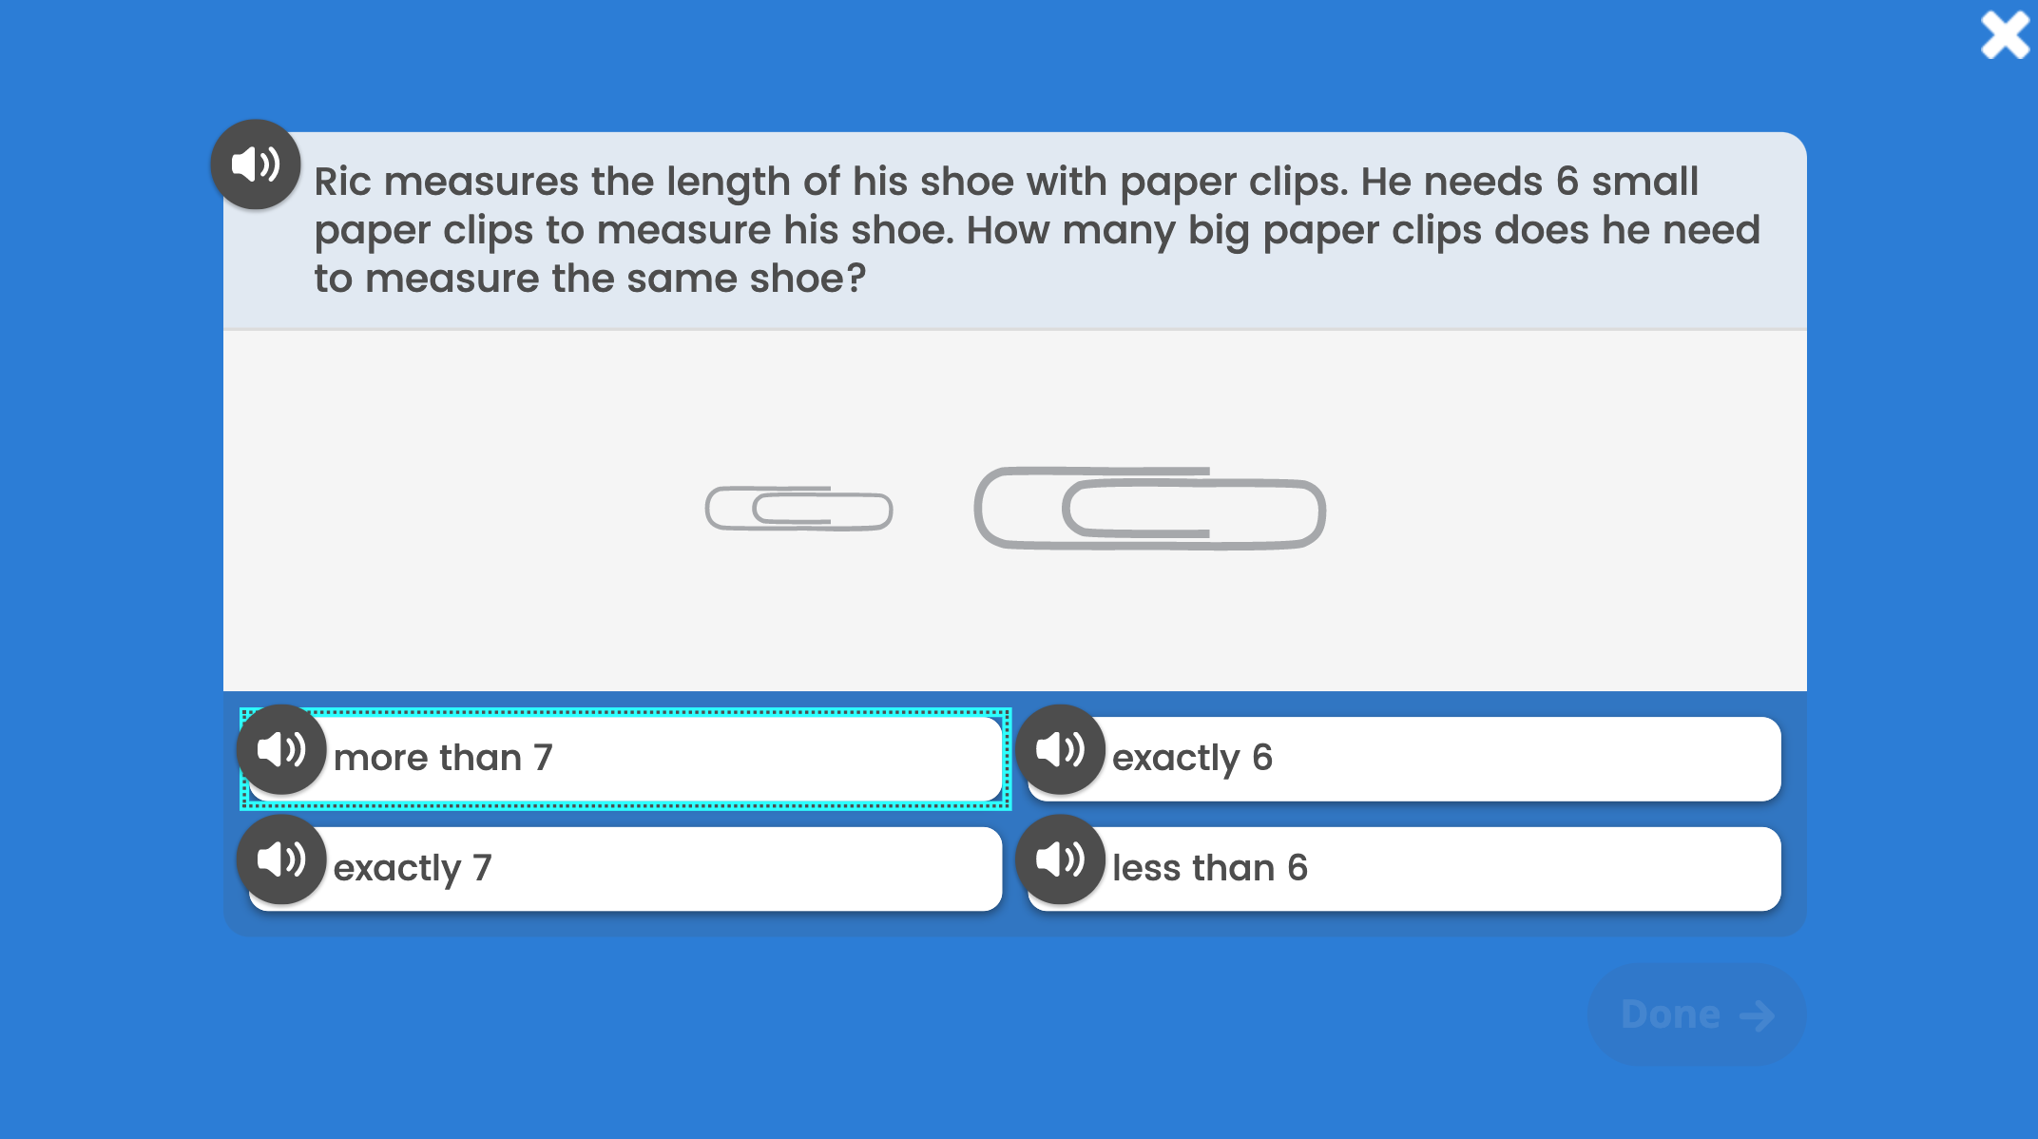
Keyboard Navigation
How: Using specific keyboard selections:
Tab, Shift + Tab, and Enter or Space
A box will appear showing
where you are on the screen.
The Tab key
will initiate keyboard navigation features.

Slide 23
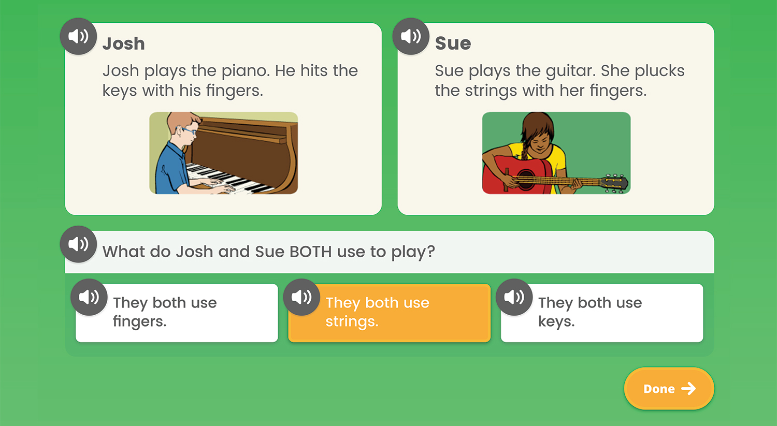
Audio Support
How: Using the speaker icon,
wherever it appears
Notes:
Audio support is currently available for Diagnostic items at these levels:
Mathematics: Grades K–5
Phonics: Grades K–3
High-Frequency Words: Grades K–3
Vocabulary: Grades K–2
Phonological Awareness: Grades K–1
Reading Comprehension: Grade K
What: Provides the ability to click on an audio button (speaker icon) to have the corresponding text for a question and/or answer read aloud
Where: For select items in the Diagnostic, based on the domain and/or level of the items

Slide 24
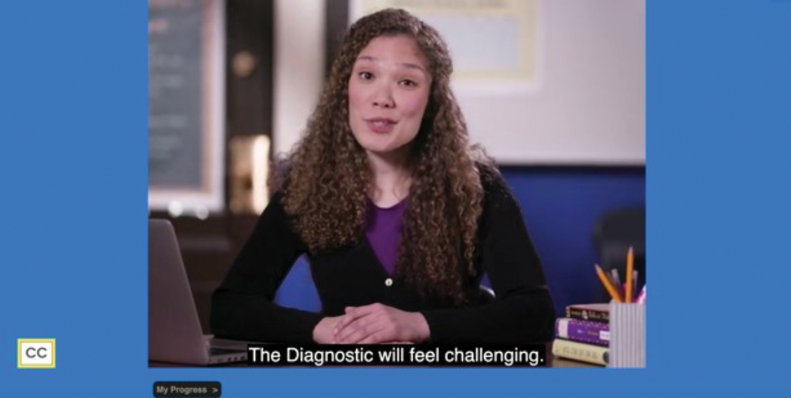
Closed Captioning
How: Using the CC box in the bottom left corner of the screen
Clicking the CC box allows you to view the text on screen.
Notes:
What: Provides the ability to display text on the computer screen that aligns to the audio
Where: In Diagnostic Introductory Videos for Grades 3+ when viewed through the student-facing Diagnostic assessment screen. Closed captioning is not available for test items at this time.

